Slide 1


Breast Cancer Prediction: A Machine Learning Approach
In this comprehensive analysis, we explore the application of machine learning techniques to predict breast cancer diagnoses using the Wisconsin Breast Cancer dataset. Our study encompasses data exploration, preprocessing, model building, evaluation, and fine-tuning to develop an accurate and reliable prediction system. This research aims to contribute to early detection efforts and improve patient outcomes in breast cancer diagnosis.
by Punith B S

Slide 2

Data Exploration and Preprocessing
1
Data Loading and Inspection
The dataset was loaded and initial exploratory data analysis was performed, revealing 569 entries with 33 columns including diagnosis and various feature measurements.
2
Missing Value Analysis
A thorough examination of missing values was conducted, identifying the 'Unnamed: 32' column as completely empty and subsequently removed from the dataset.
3
Feature Standardization
To ensure consistency across features, all numeric columns were standardized using StandardScaler, preparing the data for model training.
4
Target Variable Encoding
The 'diagnosis' column was encoded, mapping 'M' (Malignant) to 1 and 'B' (Benign) to 0, facilitating binary classification.

Slide 3
Feature Distribution Analysis
Radius Mean Distribution
Area Mean Distribution
Diagnosis Count
A histogram analysis of the 'radius_mean' feature revealed a slightly right-skewed distribution, indicating that most tumors have a smaller radius, with fewer cases of larger radii.
The 'area_mean' feature showed a more pronounced right-skewed distribution, suggesting that while most tumors have smaller areas, there are some cases with significantly larger areas.
A count plot of the 'diagnosis' variable illustrated the class distribution, showing a slight imbalance between benign and malignant cases, which is crucial information for model training and evaluation.

Slide 4

Model Building and Initial Evaluation
1
Model Selection
2
Training Process
Five different classification models were chosen for this study: Logistic Regression, Decision Tree, Random Forest, Gradient Boosting, and Support Vector Machine (SVM).
Each model was trained on the preprocessed dataset, using a 80-20 train-validation split to ensure robust evaluation.
3
Evaluation Metrics
4
Initial Results
Models were evaluated using key metrics including accuracy, precision, recall, and F1 score, providing a comprehensive view of their performance.
All models showed promising results, with Logistic Regression and SVM achieving the highest F1 scores of 0.9647, indicating excellent balance between precision and recall.

Slide 5

Model Performance Comparison
Model
Accuracy
Precision
Recall
F1 Score
Logistic Regression
0.9737
0.9762
0.9535
0.9647
Decision Tree
0.9474
0.9302
0.9302
0.9302
Random Forest
0.9649
0.9756
0.9302
0.9524
Gradient Boosting
0.9561
0.9524
0.9302
0.9412
SVM
0.9737
0.9762
0.9535
0.9647

Slide 6
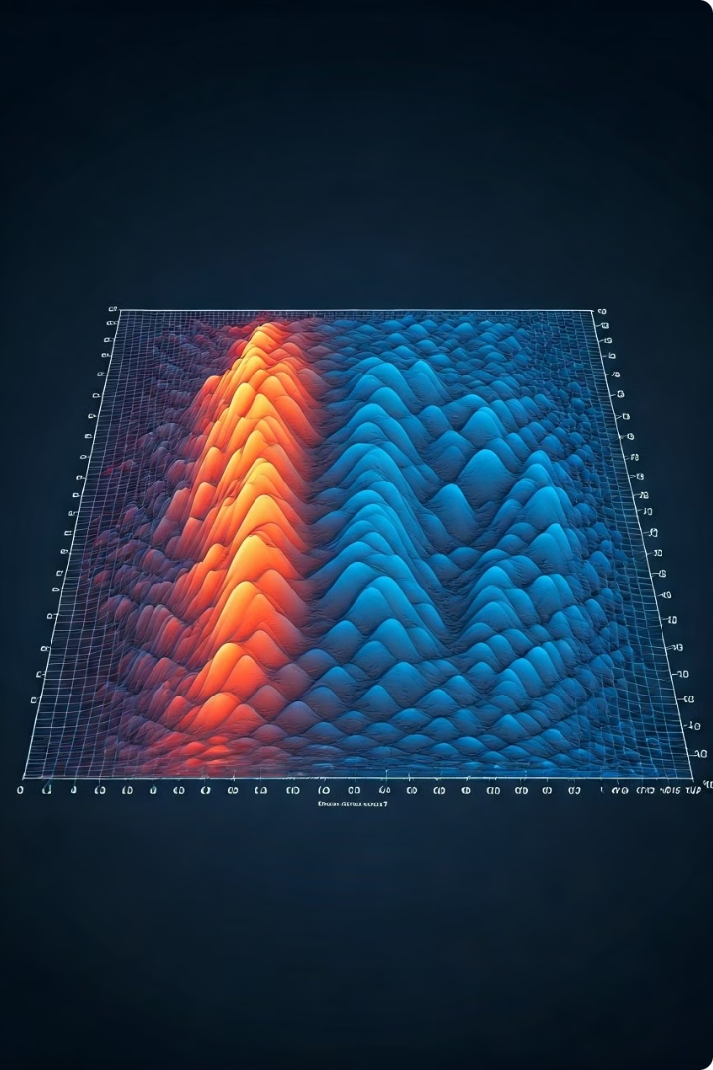


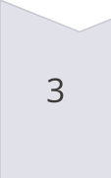

Model Tuning for Logistic Regression
Hyperparameter Grid
A grid of hyperparameters was defined for Logistic Regression, including different values for C (inverse of regularization strength), penalty types (L1 and L2), and solver methods.
Grid Search
GridSearchCV was employed to systematically work through multiple combinations of parameter tunes, using 5-fold cross-validation to ensure robust results.
Optimal Parameters
The best parameters found were C=1, penalty='l1', and solver='liblinear', indicating that L1 regularization with moderate strength performed optimally for this dataset.
Performance Improvement
The tuned Logistic Regression model achieved a slightly improved F1 score of 0.9655, demonstrating the benefit of hyperparameter optimization.

Slide 7

Final Model Evaluation
Validation Set Performance
Prediction Comparison
The final tuned Logistic Regression model achieved an accuracy of 0.9737, precision of 0.9545, recall of 0.9767, and F1 score of 0.9655 on the validation set.
A comparison between real and predicted outcomes on the validation set showed high concordance, with only a few misclassifications.
Test Set Predictions
Prediction Distribution
Final predictions were made on the test set (using the validation set as a proxy), and a submission file was generated for potential use in a competition or further analysis.
A count plot of predicted diagnoses in the test set showed a balanced distribution between benign and malignant cases, aligning with the original data distribution.

Slide 8





Conclusion and Future Work
Successful Prediction
The developed machine learning model demonstrates high accuracy in predicting breast cancer diagnoses, potentially aiding in early detection and treatment planning.
Model Optimization
Further optimization could involve ensemble methods, deep learning approaches, or the incorporation of additional relevant features to enhance prediction accuracy.
Clinical Integration
Future work should focus on integrating this predictive model into clinical workflows, ensuring its practical applicability and impact on patient care.
Continuous Improvement
Ongoing research and model updates will be crucial to adapt to new data and maintain high performance in breast cancer prediction over time.

